Slide 1
Teaching Statistics to Psychology Students using Reproducible
Computing package RC and supporting Peer Review Framework
Ian Holliday
(Aston University, UK)
Patrick Wessa
(K.U. Leuven, Belgium)

Slide 2
Background
Statistics is a requirement of the BPS GBR (British Psychological Society Graduate Basis for Chartership – the first stage towards professional status).
Undergraduate course typically include 20 credit modules in stats in both years 1 and 2 (1/6th.)
Final year must include an experimental research project work ( typically 30 credits = 1/4)
Many student’s still struggle with stats: final year dissertations reveal many students have a poor grasp of basic stats concepts
Up to 11% of published psychology research articles contain 1 or more statistical errors.

Slide 3
GAISE*
The American Statistical Association (ASA) GAISE report made six recommendations :
  Emphasize statistical literacy and develop statistical thinking
  Use real data
  Stress conceptual understanding rather than mere knowledge of procedures
  Foster active learning in the classroom
  Use technology for developing conceptual understanding and analyzing data
  Use assessments to improve and evaluate student learning
* Guidelines for Assessment and Instruction in Statistics Education

Slide 4
Garfield et al. (2002) “First Courses in Statistical Science: The Status of Educational Reform Efforts”
“It is one thing to state that statistical thinking and reasoning should be the focus of a course, or should be the desired course outcomes. It is another matter entirely to achieve this…”
“ We believe that appropriate content, a focus on data analysis and real problems, and careful use of high quality technological tools will help students better achieve the suggested course goals and outcomes.”

Slide 5
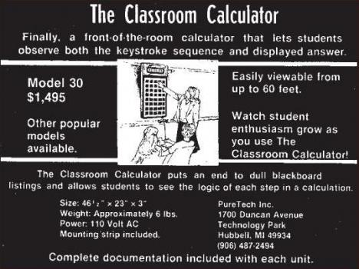
Enhancing Stats Education with New Technology ‘80s Style

Slide 6
The Reform of [Statistics] Pedagogy
Goals:
  Higher-order thinking, problem solving, flexible skills applicable to unfamiliar settings.
The old model:
  Students learn by absorbing information; a good teacher transfer information clearly and at the right rate.
The new model:
  Students learn through their own activities; a good teacher encourages and guides their learning.
What helps learning:
  Group work in and out of class; explaining and communicating; frequent rapid feedback; work on problem formulation and open-ended problems.
Moore 1997

Slide 7
Encourage “statistical thinking and literacy”.
The ‘professional’s fallacy’
  [Psychology] Students are not trainee statisticians.
  Moore: must abandon "information transfer" and adopt "constructivist" view of learning
    Emphasise statistical and conceptual thinking
    be data-focussed
    be less formulaic
    emphasise graphical concepts and automate calculation
    foster active learning
  because “the most effective learning takes place when content (what we want students to learn), pedagogy (what we do to help them learn), and technology reinforce each other in a balanced manner.” (Moore, 1997).
Moore 1997

Slide 8
A new approach to statistics Education
Within the pedagogical paradigm of (social) constructivism permitting:
  Interaction & collaboration via peer review.
  Experimentation.
Responsibility (social control)
  learning & computing technology.
  we need to Free Statistics of irreproducible research.
www.FreeStatistics.org
Wessa 2009

Slide 9
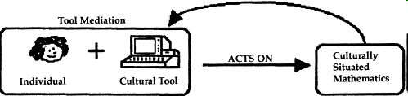
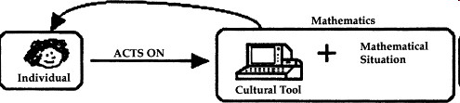
Constructivism
Social
Data Sharing and Peer reviewing via compendiums
Individual
Smith, 1998

Slide 10
Compendiums
Documents that allow us to preserve, reproduce, and re-use the results of data analysis.
  Data can be preserved and shared through the internet.
  Analysis can be studied and checked by other researchers.
  New compendiums can be created to communicate new findings.

Slide 11
‘Classical’ vs. RC Compendium
'classical' compendium
  Typically a zip file with
    data files
    R scripts
    Sweave documents ...
RC compendium
  Simple document form (ODF, PDF, .doc..)
    Containing links to remotely stored computations.
    Accessed via any browser

Slide 12
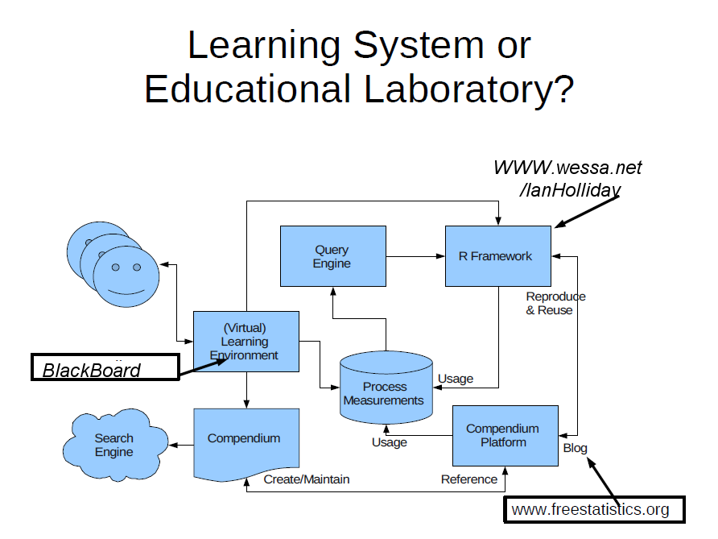
Wessa 2009

Slide 13
Features of the Compendium Platform
Any computation that is created within the R Framework can be easily archived in the repository
  there is no need for students to keep track of the data, the model parameters, or the underlying statistical software code;
Any user who visits the unique URL of an archived computation is able to instantly reproduce the computation or reuse it for further analysis
  only an internet browser (and an active connection) is required to use the repository;
Educators and researchers are able to retrieve data for research purposes.
Wessa 2008

Slide 14
What Students Do.
Assignment
Reproduce
Review
Investigate
Report
Blog

Slide 15
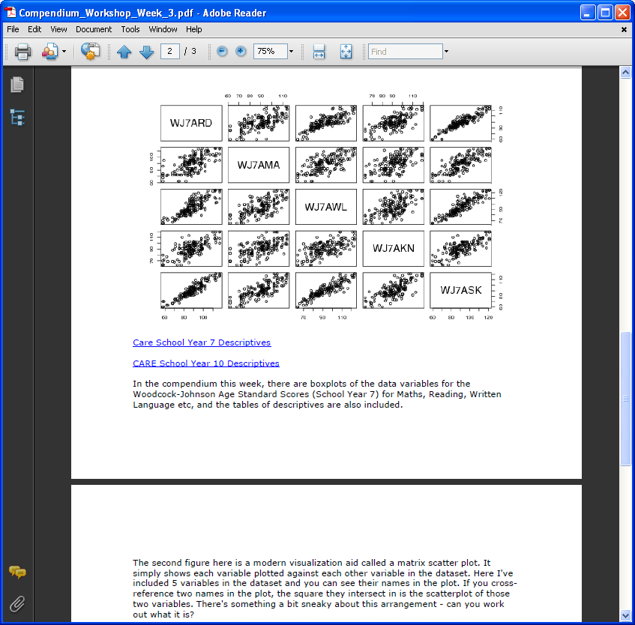
Snapshot of a Workshop Assignment Compendium
Produced in a normal word processor (here I’ve made a PDF).
Shows statistical outputs (graph, tables…)
Has links to the blogged analysis.
http://www.freestatistics.org/blog/index.php?v=date/2009/Oct/26/t1256547982lxacofnhrqf7g7w.htm/

Slide 16
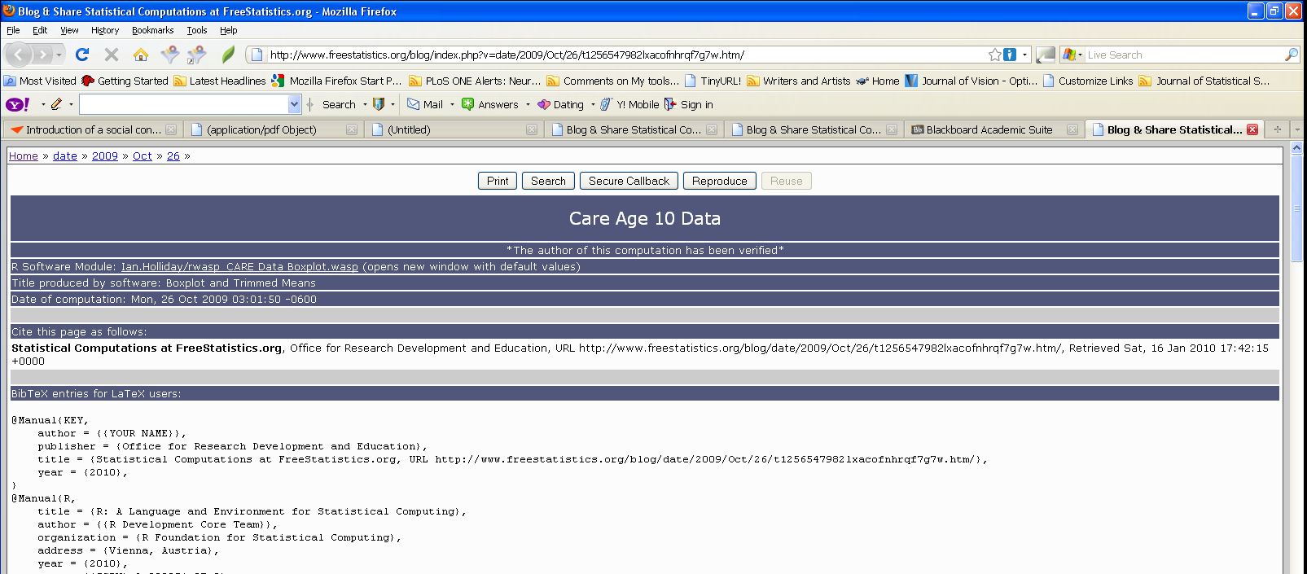
Blogged Computation
Unique blog URL to Reproducible Content
Citeable work – also for students!

Slide 17
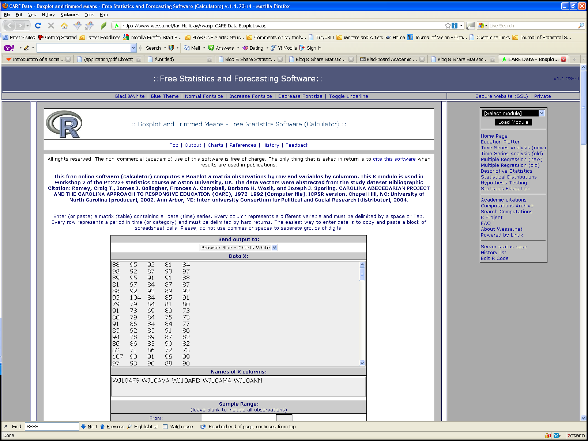
Data for the reproduced computations
Can paste in data for new analysis e.g. from excel

Slide 18
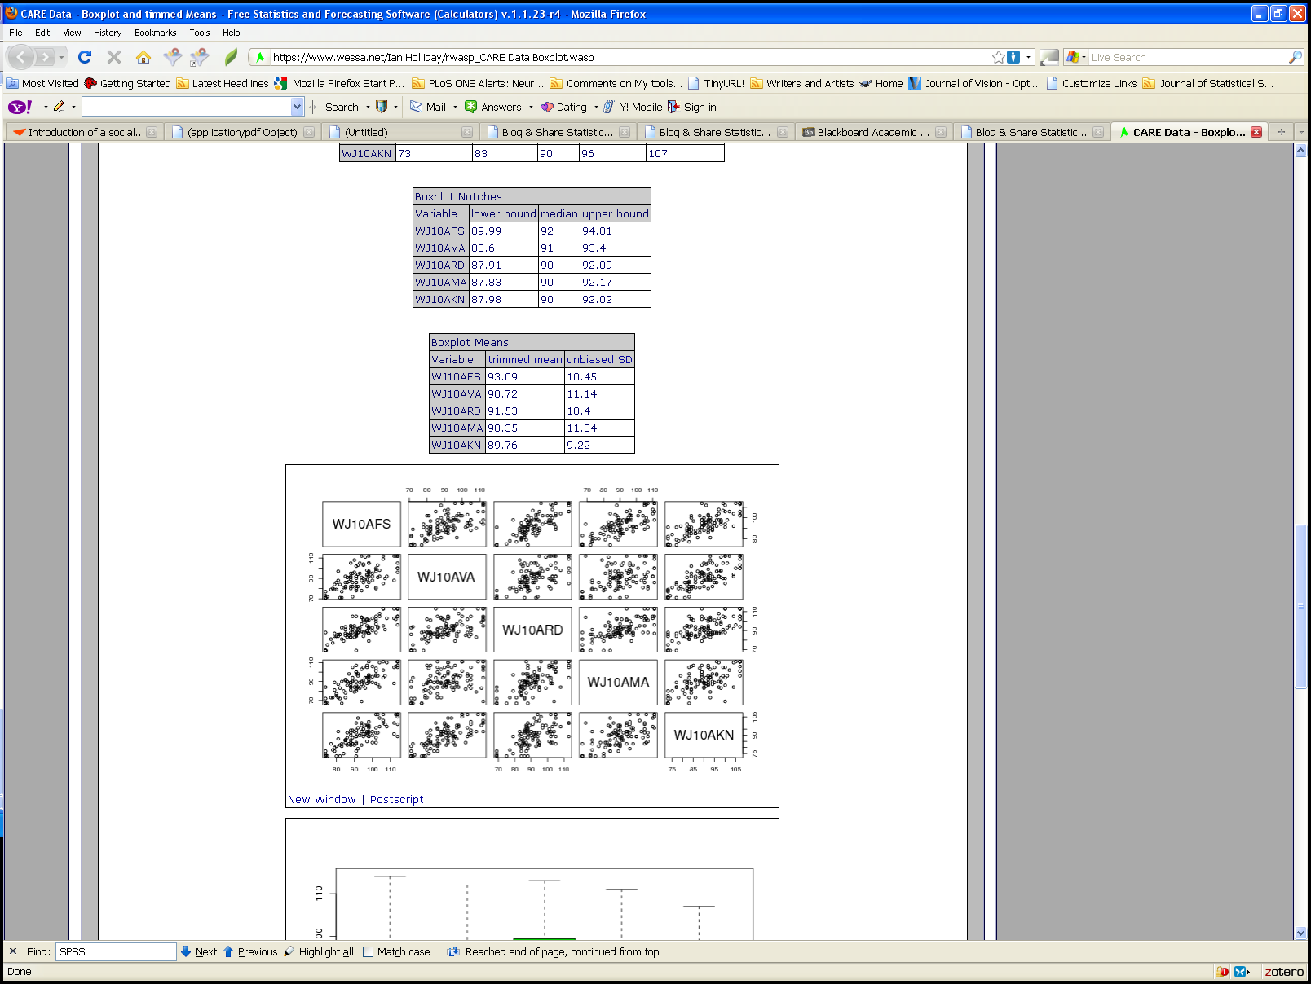
Shows the reproduced analysis.
Computation is recomputed externally by wessa.net R servers.
Enables modification and exploration using controls on the page.

Slide 19
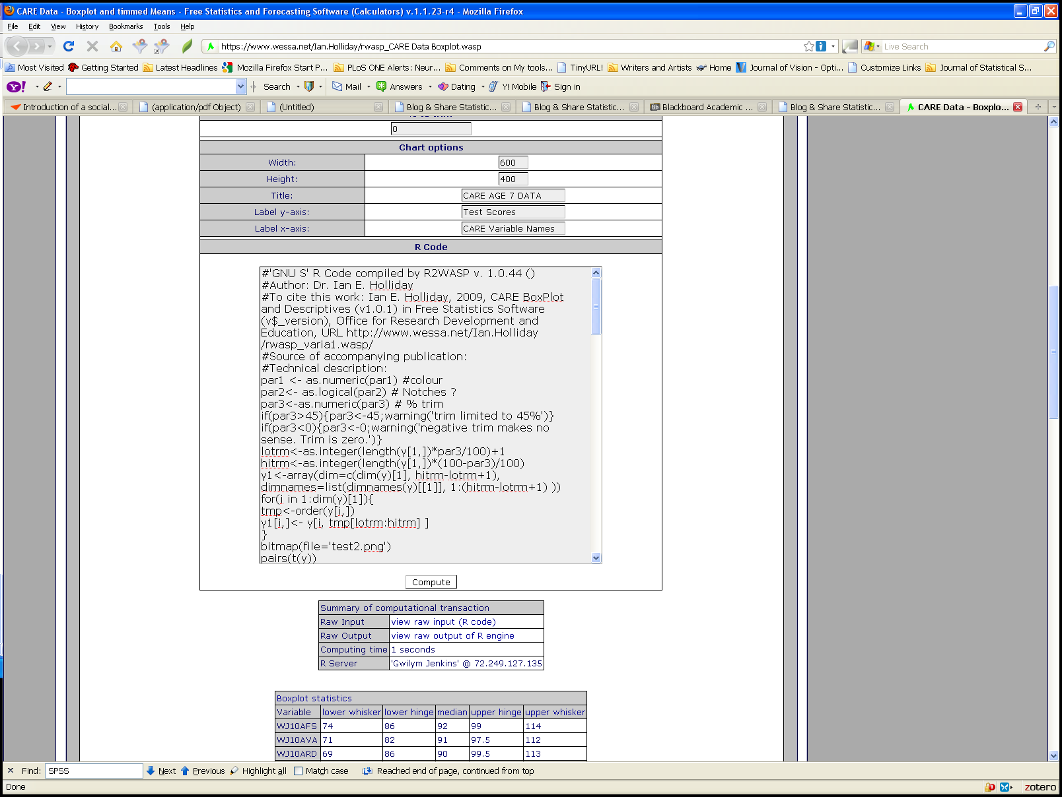
Code is shown and can be modified or re-used in new modules.
Blogged Analysis reproduced by re-computing.
Changes to analysis computed then blogged.

Slide 20
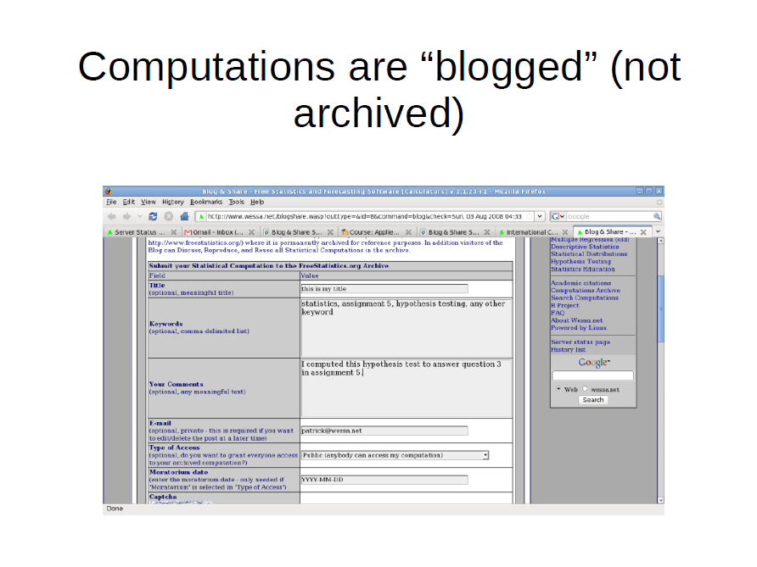

Slide 21
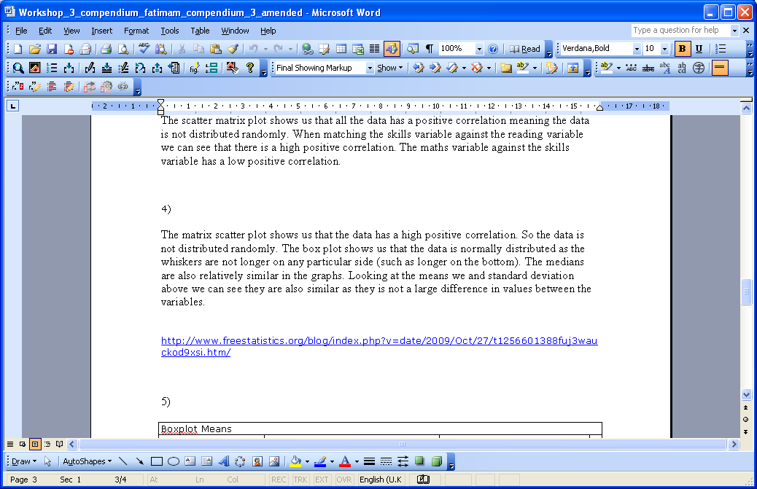
Student compendium
Produced in Word or Oo
Student’s provide links to blogs to support stats interpretation

Slide 22
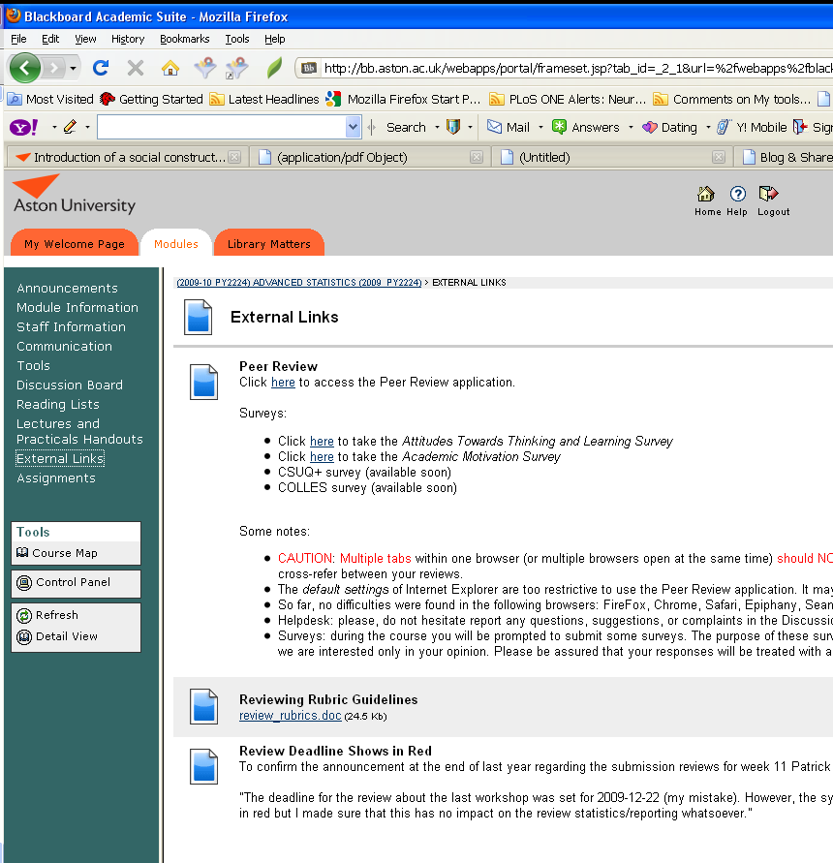
Students upload to external review site
We (attempt to!) collect student survey data.
Provide feedback guidance and support messages

Slide 23
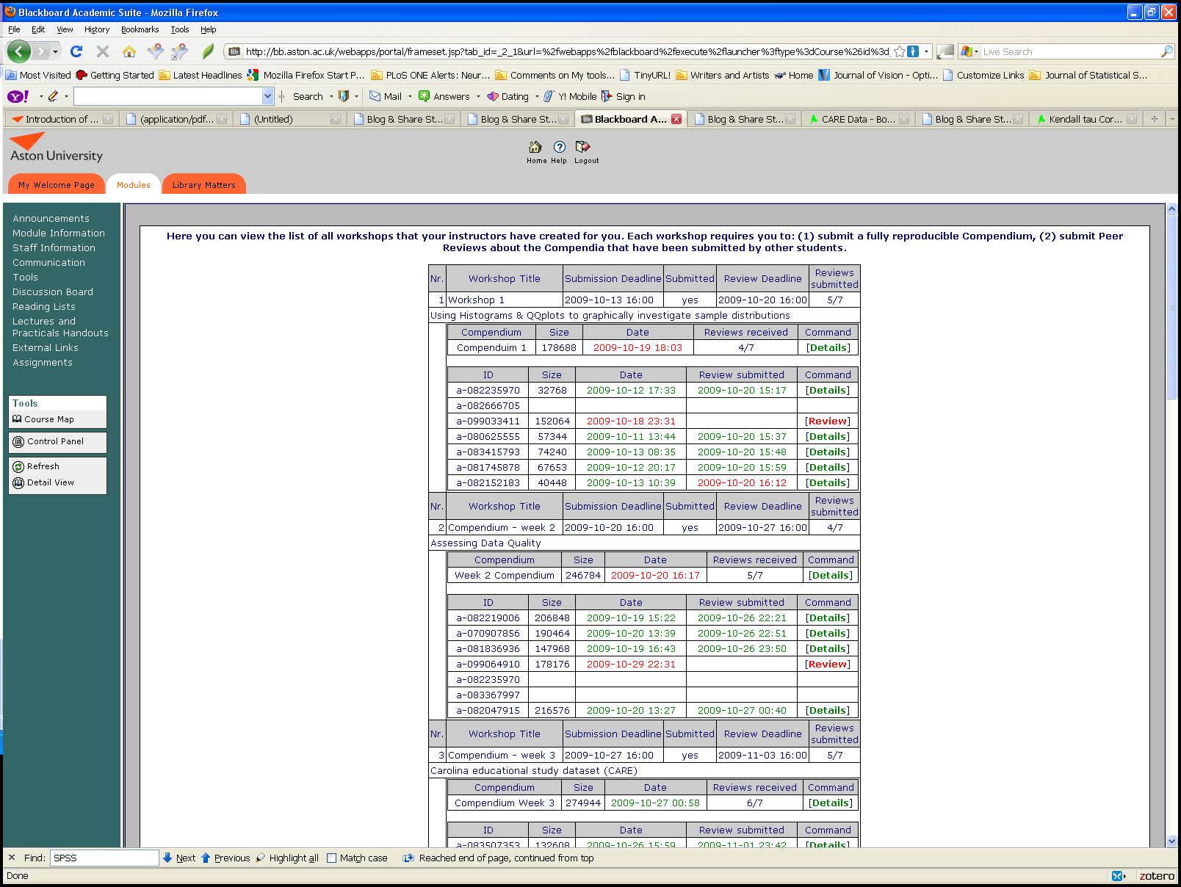
Student reviews collated and shared anonymously for peer feedback.
Stats tracked individually

Slide 24
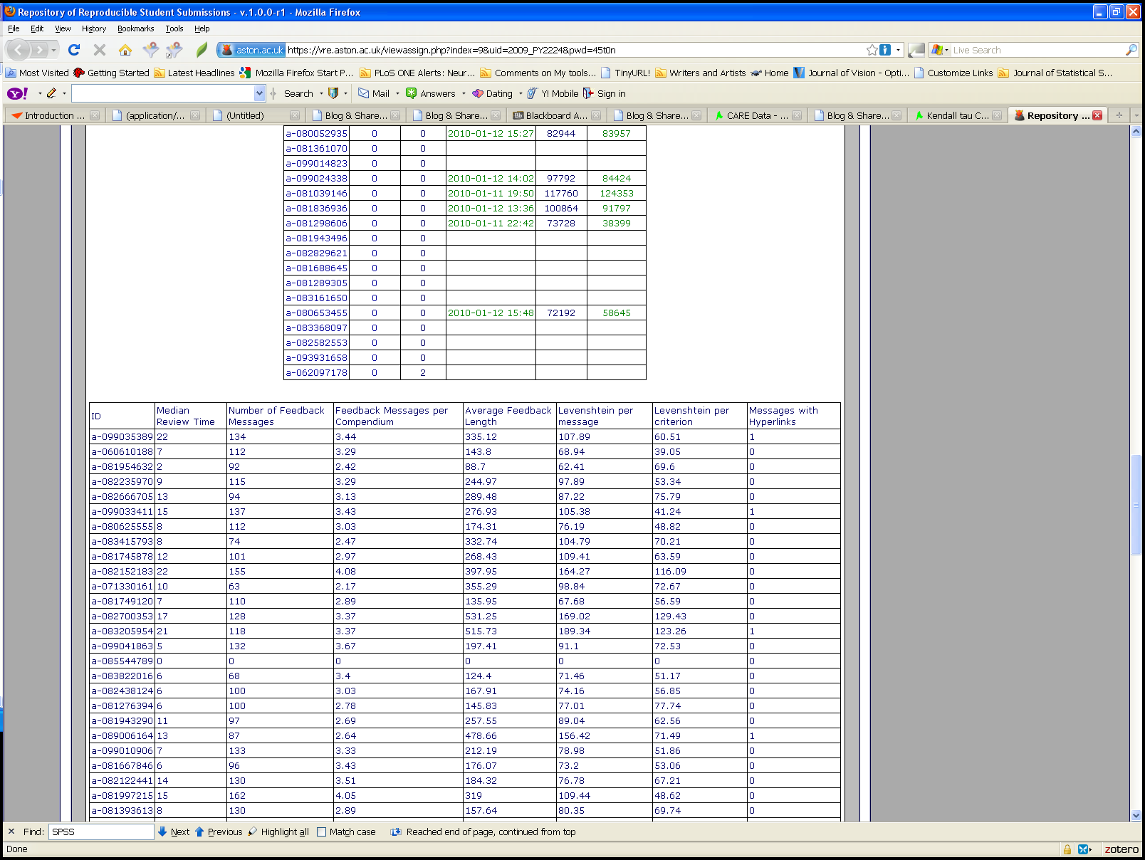
Data captured from students is analyzed within the R framework too.
This shows per student performance on several metrics e.g. feedback message length

Slide 25
Exam Results and Feedback Effort

Slide 26
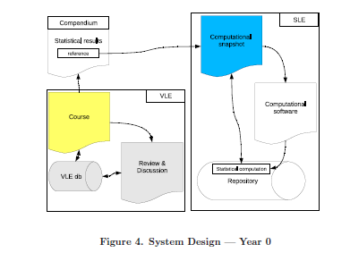
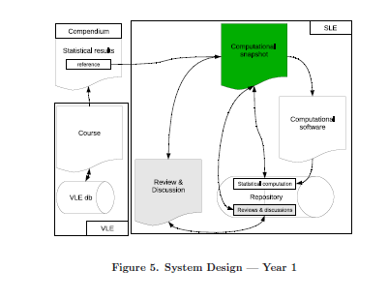
Experiment on VLE Design
Traditional VLE
Statistical LE

Slide 27
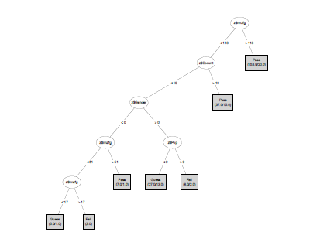
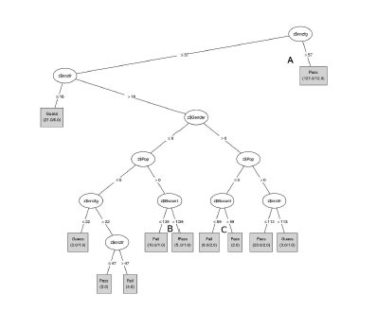
Effect of VLE DEsign
Feedback messages rate is dominant variable: threshold for pass is 118 in year 1 vs. 57 in year 2 -> large increase in efficiency
A gender bias in year 1 is eliminated in the new design

Slide 28
Issues
Course development takes a lot of effort
  But a core of material is now available
Assessment takes a lot of effort
  But on-going feedback important feature
Student resistance to workload
  Actually well-matched to course requirement.
Perceived professional status of SPSS vs. R
  Point is to learn statistics; open source tools

Slide 29
End of Presentation

